Slide 1


Introduction
By
Atul Ghumade
Internet of things | Industrial Automation Test Integrator | Machine Vision | Embedded System

Slide 2
What is Open Source?
In production and development,
open source as a development model promotes a universal access via a free license to a product's design or blueprint, and universal redistribution of that design or blueprint, including subsequent improvements to it by anyone.

Slide 3

Closed source Vs Open source
Open as in free
Open as in access
Open as in over time
Open as in not closed
Open as in reuse and change
Open as in any place and for anyone

Slide 4
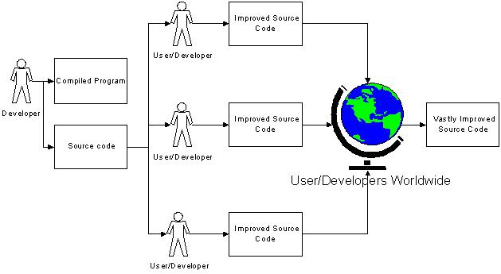
How open source works?

Slide 5
EXAMPLES OF OPEN SOURCE
Application software
7-Zip
Eclipse
GIMP
Chromium
Blender
Mozilla Firefox
Open Office
Operating Systems:
Android
Linux
FreeBSD
ReactOS
Haiku
FreeDOS
Programming Language :
  Perl
  PHP
  Python
  Ruby on Rails
  PHDL
  Prolog
Hardware :
Raspberry Pi
Arduino
3D printer
Beaglebone black
Red pitaya
Sixth sense technology by Pranav mistry

Slide 6
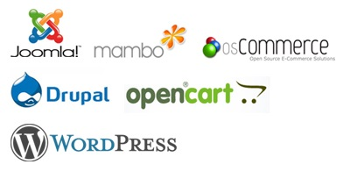
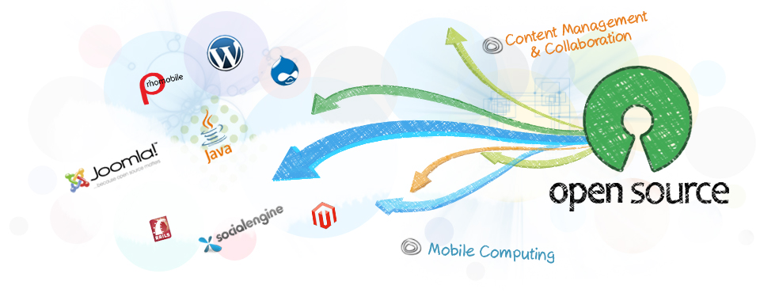
EXAMPLES OF OPEN SOURCE
Server Software:

Slide 7
Do you know what you can Build by using open source platform?
The “Awesomest” project in the world
A project which can change your life
Not a college project, a project which will make your business.
Beyond the imagination.

Slide 8
Think what you can make.

Slide 9
Try to login:
Instructable.com
Github.com
Opensource.org

Slide 10

Lets talk about one of the best Open source programming language
PYTHON

Slide 11
Brief History of Python
Invented in Netherlands, 1989 by Sir Guido van Rossum
Named after Monty Python Circus
Open source from the beginning
Used by Google from the beginning
80 Versions launched up to 4th of Oct 2014
Python language is written in C and C++
“Jython” is written in Java for the JVM
“Iron Python” is written in C# for the .Net environment

Slide 12
Why Python?
Python is:
Very easy to learn
Relatively fast
Object-oriented
Strongly typed
Widely used
Portable
Garbage Collector
C is much faster than Python but much harder to understand and use
Perl is slower
R is more of programming language for Statistics

Slide 13
Why we are learning Python?
Easy to learn.
Lots of web based, GUI based etc products are frequently building in Python.
Sources and Helping hands are available on Internet.
Very Important – Its One of the highest paid technology.

Slide 14
Python Features:
Easy-to-learn
Easy-to-read.
Easy-to-maintain
A broad standard library
Interactive Mode
Portable
Extendable
Databases
GUI Programming
Scalable

Slide 15
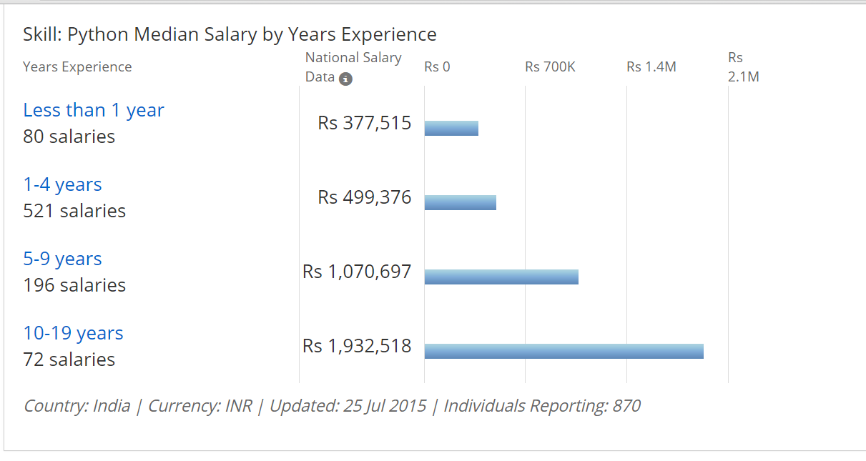
Highest paid technology:

Slide 16
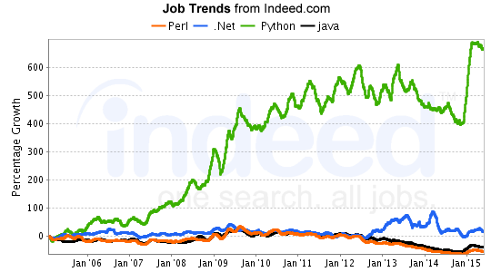
Statistics by Indeed:

Slide 17
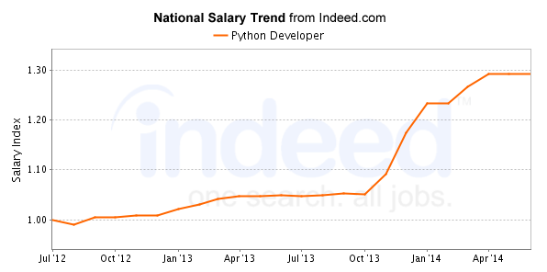

Slide 18
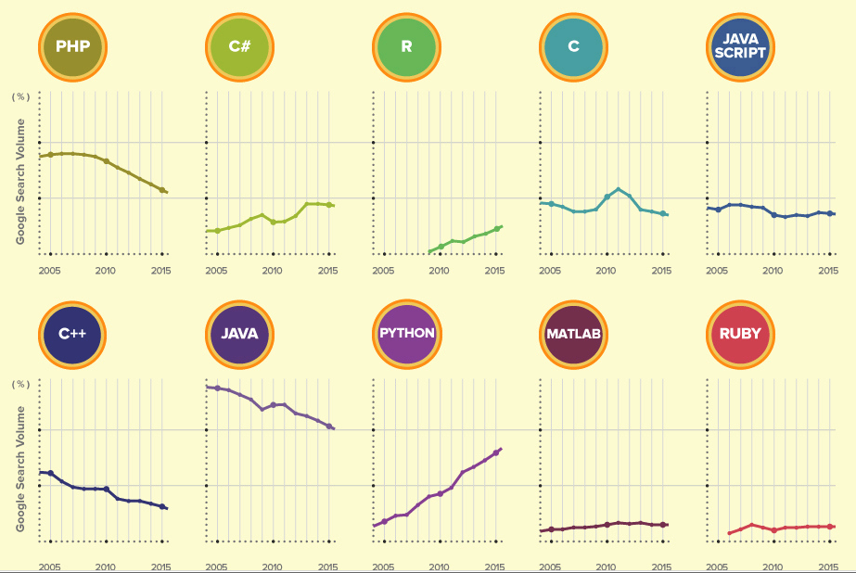

Slide 19
So why are we waiting?
lets Start with Python….
And
Enjoy programming.

Slide 20
Thank you
Atul Ghumade
atulghumade69@gmail.com
+919860013298

